Slide 1
Aggie Honor Bot
Trevor Bolton | Rebecca McFadden | Neel Pochareddy | Albin Kyle Myscich

Slide 2
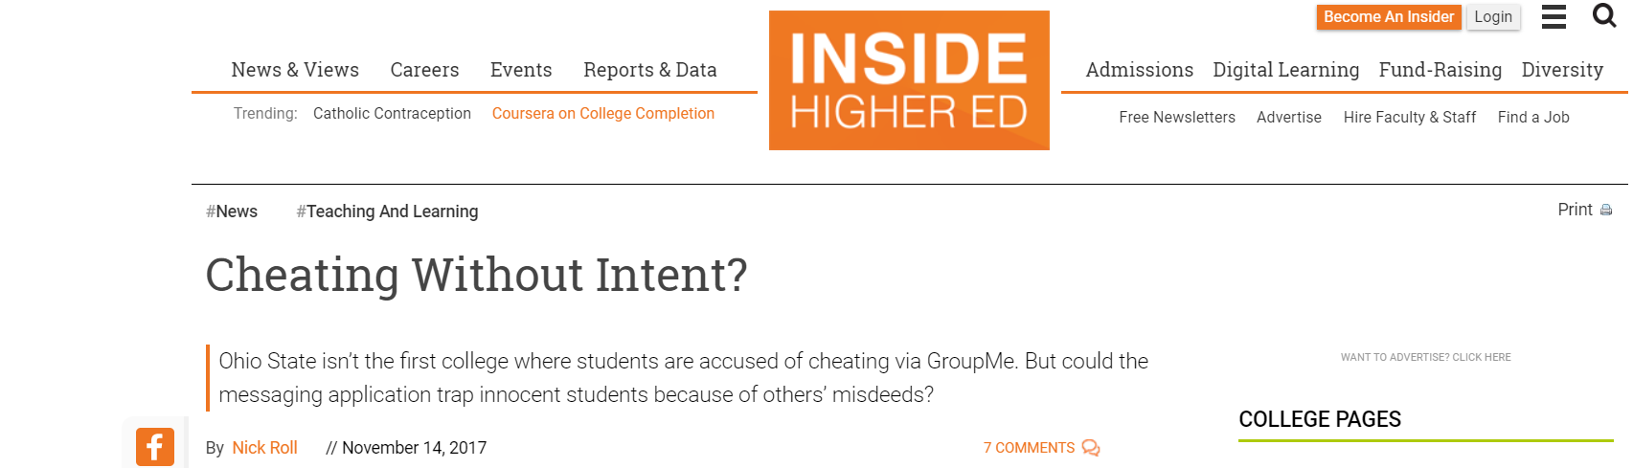
“Cheating?”
Guilt by association
Control entirely our of your hands
Forced to drop out of a group chat
Risking academic honesty
“Could GroupMe Lead to Cheating Guilt by Association?” Could GroupMe Lead to Cheating Guilt by Association?, www.insidehighered.com/news/2017/11/14/could-groupme-lead-cheating-guilt-association.

Slide 3
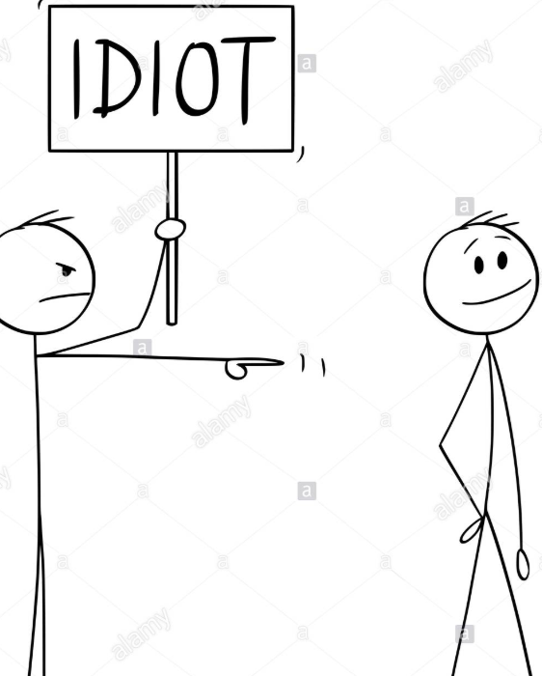
Problems with Current GROUPME chats
Once someone cheats anyone is liable to be charged for academic dishonesty
This is unfair as students are getting in trouble for things they did not do

Slide 4
WHAT IF THERE WAS A SOLUTION??

Slide 5
AGGIE-HONOR-BOT

Slide 6
HOW DID WE DO IT??
Parent
Child
Server.js
Add bot to groups
Report messages
Bot.js
Listen and compile messages
Interact with users

Slide 7
Q/A

